Slide 1
GPU ARCHITECTURE
1.1 GPUs as Parallel Computers
1.2 Architecture of a Modern GPU
1.3 Why More Speed or Parallelism?
1.4 Parallel Programming Languages and Models
2.1 Evolution of Graphics Pipelines
2.2 GPU Computing
D. Kirk and W. Hwu , “Programming Massively Parallel Processors –A Hands-on approach”, Elsevier Inc., 1st Edition

Slide 2
1.1 GPUs AS PARALLEL COMPUTERS
Semiconductor industry has two main paths for designing MP:
1. Multicores began as two-core processors, with the number of cores doubling.
Eg: Intel Corei7 MP which has 4 processor cores, each of which is an out-of-order, multiple instruction issue processor implementing the full x86 instruction set.
This MP supports hyperthreading with two hardware threads per core and is designed to maximize the exec speed of sequential programs.
2. In contrast, the many-core trajectory focuses more on the execution throughput of parallel applications.
The many-cores began as a large number of much smaller cores.
Eg: The NVIDIA GeForce GTX 280 graphics processing unit (GPU) with 240 cores, each of which is a heavily multithreaded.
Many-core processors, especially the GPUs, dominated the race of FP-performance.
While the performance improvement of general-purpose MPs has slowed significantly, the GPUs have continued to improve uncompromisingly.

Slide 3
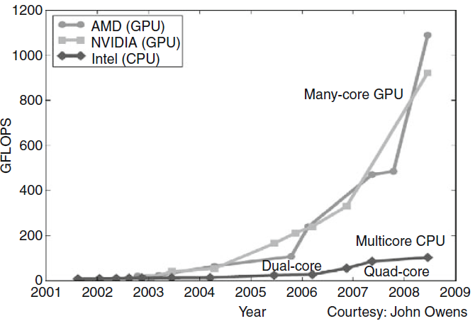
1.1 GPUs AS PARALLEL COMPUTERS (Contd..)
The ratio between many-core GPUs and multicore CPUs for peak floating-point calculation throughput is about 10 to 1.

Slide 4
1.1 GPUs AS PARALLEL COMPUTERS (Contd..)
Such a large performance gap between parallel and sequential execution has motivated many app developers to move the computationally intensive parts of their software to GPUs for execution.
These computationally intensive parts are the prime target of IIel pgming.
When there is more work to do, there is more opportunity to divide the work among cooperating parallel workers.
Q: Why there is such a large performance gap between many-core GPUs and general-purpose multicore CPUs?
Ans: It lies in the differences in the fundamental design philosophies between the two types of processors, as shown below:

Slide 5
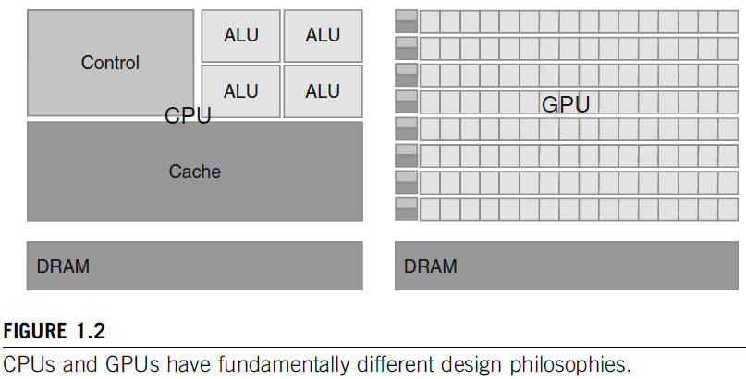
1.1 GPUs AS PARALLEL COMPUTERS (Contd..)

Slide 6
1.1 GPUs AS PARALLEL COMPUTERS (Contd..)
The design of a CPU is optimized for sequential code performance.
It makes use of sophisticated control logic to allow instructions from a single thread of execution to execute in parallel.
More over, large cache memories are provided to reduce the instruction and data access latencies of large complex applications.
Neither control logic nor cache memories contribute to the peak calculation speed.
Memory bandwidth is another important issue.
Graphics chips have operating at approximately 10 times the BW of CPU chips.
Eg: GeForce 8800 GTX, was capable of moving data at about 85 gigabytes per second (GB/s) in and out of its DRAM.
General-purpose processors have to satisfy requirements from OS, apps, and I/O devices that make memory BW more difficult to increase.
In contrast, with simpler memory models and lesser constraints, the GPU designers can more easily achieve higher memory BW.

Slide 7
1.1 GPUs AS PARALLEL COMPUTERS (Contd..)
The more recent NVIDIA GT200 chip supports about 150 GB/s.
MP system memory BW has not grown beyond 50 GB/s for about 3 years.
The GPUs is shaped by the fast growing video game industry.
Game industry which exerts tremendous economic pressure for the ability to perform a massive number of FP-calculations per video frame in advanced games.
This demand motivates the GPU vendors to optimize the execution throughput.
The HW takes advantage of a large number of execution threads to find work to do.
Small cache memories are provided to help the BW requirements of apps, so multiple threads that access the same memory data need not always access the DRAM.
Most apps will use both CPUs and GPUs, executing the sequential parts on the CPU and numerically intensive parts on the GPUs.

Slide 8
1.1 GPUs AS PARALLEL COMPUTERS (Contd..)
From 2007 with the release of CUDA, NVIDIA made the ease of parallel programming.

Slide 9
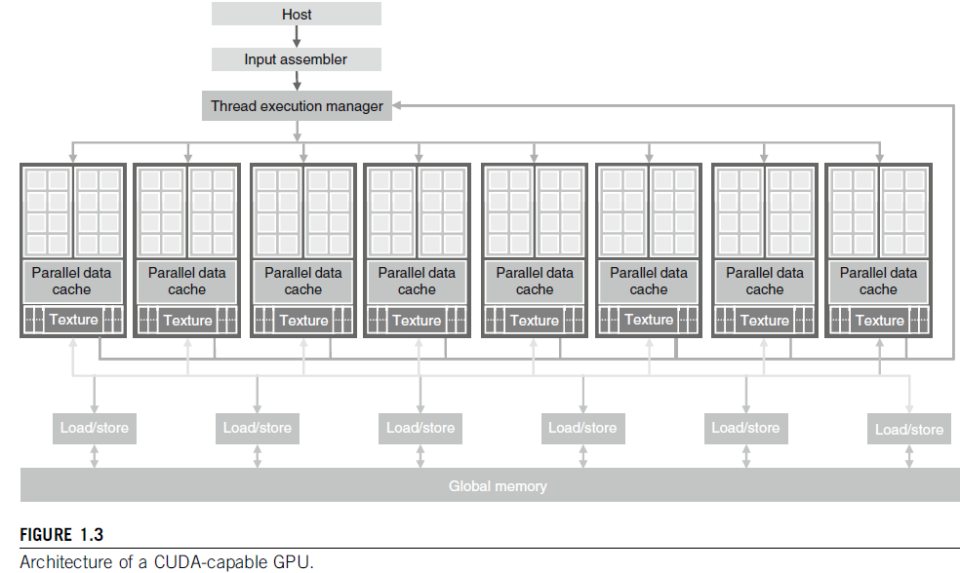
1.2 ARCHITECTURE OF A MODERN GPU
CUDA-capable GPU is organized into an array of highly threaded streaming multiprocessors (SMs).
In Fig, two SMs form a building block.
The no of SMs in a building block can vary from one gen of CUDA GPUs to another.

Slide 10
1.2 ARCHITECTURE OF A MODERN GPU (Contd..)
Each SM has a number of streaming processors (SPs) ..
Each GPU currently comes with up to 4 GB of graphics double data rate (GDDR) DRAM, referred to as global memory.
These GDDR DRAMs differ from the system DRAMs on the CPU motherboard and essentially used for graphics as the frame buffer memory.
For graphics applications, they hold video images, and texture information for three-dimensional (3D) rendering, but for computing they function as very-high-bandwidth memory.
GPU G80 chip has 128 SPs (16 SMs, each with 8 SPs).
With 128 SPs, a total of over 500 gigaflops.
With 240 SPs, the GT200 exceeds 1 teraflops.
Because each SP is massively threaded, it can run thousands of threads per application.
A good application typically runs 5000–12,000 threads simultaneously on this chip.

Slide 11
1.2 ARCHITECTURE OF A MODERN GPU (Contd..)
Note that Intel CPUs support 2 or 4 threads per core.
The G80 chip supports up to 768 threads per SM, which sums up to about (768 x 16 (approx)= 12,000 threads for this chip.
The more recent GT200 supports 1024 threads per SM and up to about 30,000 threads for the chip.
Thus, the level of parallelism supported by GPU hardware is increasing quickly.
It is very important to struggle and attempt for such levels of parallelism when developing GPU parallel computing applications.

Slide 12
1.3 WHY MORE SPEED OR PARALLELISM?
Q: Why applications will continue to demand increased speed?
Ans: Many applications that we have today seem to be running quite fast enough.
When an application is suitable for parallel execution, a good implementation on a GPU can achieve more than 100 times (100) speedup over sequential execution.
Many applications of the future will be what we currently consider to be supercomputing applications (Superapps).
For example, bioinformatics is moving more and more into the molecular level. Microscopes, the most important instrument in molecular biology, used to rely on optics or electronic instrumentation, but there are limitations to the molecular-level observations.
These limitations can be effectively addressed by incorporating a computational model to simulate the underlying molecular activities.
From the simulation we can measure even more details and test more hypotheses than with traditional instruments.

Slide 13
1.3 WHY MORE SPEED OR PARALLELISM? (Contd..)
These enhancements will have tremendous effects to science and medicine.
For applications such as video and audio coding.
Consider digital high-definition television (HDTV) versus older National Television System Committee (NTSC) television.
Once we experience the level of details offered by HDTV, it is very hard to go back to older technology.
All the processing that is necessary for that HDTV is a very parallel process, as are 3D imaging and visualization.

Slide 14
1.3 WHY MORE SPEED OR PARALLELISM? (Contd..)
Similar developments with electronic gaming.
Imagine driving a car in a game today; the game is, in fact, simply a prearranged
set of scenes.
If your car bumps into an obstacle, the course of your vehicle does not change; only the game score changes.
Your wheels are not bent or damaged, and it is no more difficult to drive, regardless of whether you bumped your wheels or even lost a wheel.
With increased computing speed, the games can be based on dynamic simulation rather than prearranged scenes.
We can expect to see more of these realistic effects in the future—accidents will damage your wheels, and your online driving experience will be much more realistic.

Slide 15
1.3 WHY MORE SPEED OR PARALLELISM? (Contd..)
Applications that involve simulation with tremendous amounts of data being processed.
And, with this huge quantity of data, much of the computation can be done on different parts of the data in parallel.
Q: How many times speedup can be expected from parallelizing these superapplication?
A: It depends on the portion of the application that can be parallelized.
If the % of time spent in the part that can be parallelized is 30%,
a 100 speedup of the parallel portion will reduce the execution time by 29.7%.
The speedup for the entire application will be 1.43.
Therefore, it is imp that an appli has the vast majority of its exec in the llel portion for a massively llel processor to effectively speedup its execution.

Slide 16
1.3 WHY MORE SPEED OR PARALLELISM? (Contd..)
The level of speedup achieved can also reflect the suitability of the CPU to the application.
In some applications, CPUs perform very well, making it more difficult to speed up performance using a GPU.
Some applications have portions that can be much better executed by the CPU.
Thus properly exploiting the heterogeneous parallel computing capabilities of the combined CPU/GPU system.
D. Kirk and W. Hwu , “Programming Massively Parallel Processors –A Hands-on approach”, Elsevier Inc., 1st Edition, 2010

Slide 17
1.4 PARALLEL PROGRAMMING LANGUAGES AND MODELS
Parallel programming languages that are the most widely used are the MPI for scalable cluster computing
And is a model where computing nodes in a cluster do not share memory
All data sharing and interaction must be done through explicit message passing. MPI have been known to run successfully on cluster computing systems with more than 100,000 nodes.
The amount of effort required to port an application into MPI, however, can be extremely high due to lack of shared memory across computing nodes.
CUDA and OpenCL provides shared memory for parallel execution in the GPU.
Programmers need to manage the data transfer between the CPU and GPU.

Slide 18
1.4 PARALLEL PROGRAMMING LANGUAGES AND MODELS (Contd..)
OpenMP supports shared memory, however, it has not been able to scale beyond a couple hundred computing nodes due to thread management overheads.
Aspects of CUDA are similar to both MPI and OpenMP in that the programmer manages the parallel code constructs.
In OpenMP compilers do more of the automation in managing parallel execution.
Developers who are experienced with MPI and OpenMP will find CUDA easy to learn.
Several major industry players, including Apple, Intel, AMD/ATI, and NVIDIA, have jointly developed a standardized programming model called OpenCL [Khronos 2009].

Slide 19
1.4 PARALLEL PROGRAMMING LANGUAGES AND MODELS (Contd..)
Similar to CUDA, the OpenCL programming model defines language extensions and runtime APIs to allow programmers to manage parallelism and data delivery.
The level of programming constructs in OpenCL is still at a lower level than CUDA and much more tedious to use.
Also, the speed achieved in an application expressed in OpenCL is still much lower than in CUDA on the platforms that support both.
Because programming massively parallel processors is motivated by speed, we expect that most who program massively parallel processors will continue to use CUDA.
Finally, those who are familiar with both OpenCL and CUDA know that there is a remarkable similarity between the key features of OpenCL and CUDA.

Slide 20
1.3 WHY MORE SPEED OR PARALLELISM?
Q: Why applications will continue to demand increased speed?
Ans: Many applications that we have today seem to be running quite fast enough.
When an application is suitable for parallel execution, a good implementation on a GPU can achieve more than 100 times speedup over sequential execution.
supercomputing applications (Superapps).
For example, bioinformatics is moving more and more into the molecular level.
From the simulation we can measure even more.
High-definition TV (HDTV) versus older National TV System Committee (NTSC).
Once we experience the level of details offered by HDTV, it is very hard to go back to older technology.
All the processing that is necessary for that HDTV is a very parallel processing.
Similar developments with electronic gaming.
Imagine driving a car in a game; the game is, in fact, simply a prearranged set of scenes.
If your car bumps into an obstacle, only the game score changes.
We can expect to see more of these realistic effects in the future—accidents will damage your wheels, and your online driving experience will be much more realistic.
Q: How many times speedup can be expected from parallelizing these superapplication?
A: It depends on the portion of the application that can be parallelized.
If the % of time spent in the part that can be parallelized is 30%,
a 100 speedup of the parallel portion will reduce the execution time by 29.7%.
The speedup for the entire application will be 1.43.

Slide 21
1.4 PARALLEL PROGRAMMING LANGUAGES AND MODELS
explicit message passing. MPI have been known to run successfully on cluster computing systems with more than 100,000 nodes.
CUDA and OpenCL provides shared memory for parallel execution in the GPU.
Programmers need to manage the data transfer between the CPU and GPU.
The speed achieved is still much lower than in CUDA on the platforms that support both.
Finally, those who are familiar with both OpenCL and CUDA know that there is a remarkable similarity between the key features of OpenCL and CUDA.

Slide 22
2.1 EVOLUTION OF GRAPHICS PIPELINES
The advancement of graphics H/W has been driven for high-quality, real-time graphics in computer applications.
In an electronic gaming application, one needs to render complex scenes at an ever-increasing resolution at a rate of 60 frames per second.
2.1.1 The Era of Fixed-Function Graphics Pipelines
Fig. shows a fixed-function graphics pipeline in early NVIDIA GeForce GPUs.
Host i/f receives graphics commands and data from the CPU.
The host i/f contains DMA H/W to transfer bulk of data to and from the host system memory to the graphics pipeline.

Slide 23

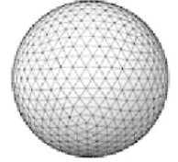

2.1 EVOLUTION OF GRAPHICS PIPELINES (Contd..)
The host i/f also communicates back, with the status and result of executing the commands.
“vertex” usually refers to the corner of a polygon.
The GeForce pipeline is designed to render triangles.
The surface of an object is drawn as a collection of triangles.
The finer the sizes of the triangles are, the better the quality of the picture.
In Fig. the vertex control stage receives triangle data from the CPU.
The vertex control stage then converts the triangle data into a form that the H/W understands and places the prepared data into the vertex cache.

Slide 24

2.1 EVOLUTION OF GRAPHICS PIPELINES (Contd..)
The vertex shading, transform, and lighting (VS/T&L) stage transforms vertices and assigns per-vertex values (e.g., colors, brightness.
The shading is done by the pixel shader hardware.
The vertex shader can assign a color to each vertex, but color is not applied to triangle pixels until later.
The triangle setup stage further creates edge equations that are used to include colors and other per-vertex data (such as texture coordinates) across the pixels touched by the triangle.
Raster stage det which pixels are contained in each triangle.
For each of these pixels, the raster stage includes per-vertex values necessary for shading the pixel, including the color, position, and texture that will be shaded (painted) on the pixel.

Slide 25
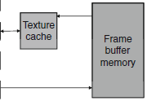

2.1 EVOLUTION OF GRAPHICS PIPELINES (Contd..)
The shader stage determines the final color of each pixel.
Many effects that make the rendered images more realistic are incorporated in the shader stage.

Slide 26
2.1 EVOLUTION OF GRAPHICS PIPELINES (Contd..)
Fig. illustrates texture mapping, the shader stage functionalities.
Here a world map texture is mapped onto a sphere object.
Sphere object is described as a large collection of triangles.
Shader stage must perform
a coordinate transform calculations to identify the exact coordinates of the texture point that will be painted on a point in one of the triangles.
ii) the total number of pixels covered by the image requires the shader stage to perform a very large number of coordinate transforms for each frame.
Sphere with no texture
Texture image
Sphere with texture

Slide 27
2.1 EVOLUTION OF GRAPHICS PIPELINES (Contd..)
The raster operation (ROP) stage in Fig. performs the final raster operations on the pixels.
It performs color raster operations that blend the color of overlapping/adjacent objects for transparency and antialiasing effects.
It also determines the visible objects for a given viewpoint and discards the obstructed pixels.
A pixel becomes obstructed when it is blocked by pixels from other objects according to the given view point.
Sphere with no texture
Texture image
Sphere with texture

Slide 28
2.1 EVOLUTION OF GRAPHICS PIPELINES (Contd..)
Triangle geometry Aliased Antialiased
Fig. illustrates antialiasing, one of the ROP(Raster opertn) stage operations.
Notice the three adjacent triangles with a black background.
In the aliased output, each pixel assumes the color of one of the objects.
The limited resolution makes the edges look crooked (bent) and the shapes of the objects distorted.
The problem is that many pixels are partly in one object and partly in another object or the background.

Slide 29
2.1 EVOLUTION OF GRAPHICS PIPELINES (Contd..)
Triangle geometry Aliased Antialiased
Forcing these pixels to assume the color of one of the objects introduces distortion into the edges of the objects.
The antialiasing operation gives each pixel a color that is linearly combined, from the colors of all the objects and background that partially overlap the pixel.
The contribution of each object to the color of the pixel is the amount of the pixel that the object overlaps.

Slide 30
2.1 EVOLUTION OF GRAPHICS PIPELINES (Contd..)
Finally, the frame buffer interface (FBI) stage manages memory reads from and writes to the display frame buffer memory.
For high-resolution displays, there is a very high bandwidth requirement in accessing the frame buffer.
Such bandwidth is achieved by two strategies:
One is that graphics pipelines typically use special memory designs that provide higher B/W than the system memories.
FBI sim manages multiple mem channels that connect to multiple mem banks. The combined B/W gives the frame buffers much higher B/W than system memories.

Slide 31
2.1 EVOLUTION OF GRAPHICS PIPELINES (Contd..)
Such high memory B/W has become a distinguishing feature of modern GPU design.
Although each generation introduced additional H/W and configurability to the pipeline stages, developers were asked for more new features than could be reasonably offered as built-in fixed functions.
The obvious next step was to make some of these graphics pipeline stages into programmable processors.

Slide 32
2.1.2 EVOLUTION OF PROGRAMMABLE REAL-TIME GRAPHICS
A single frame, rendered in 1/60th of a second, might have a million triangles and 6 million pixels.
….Such variation has motivated the hardware designers to make those pipeline stages programmable.
Two programmable stages:
i) Vertex shader programs map the positions of triangle vertices onto the screen, altering their position, color, or orientation. Typically, a vertex shader reads a floating-point (x, y, z, w) vertex position and computes a floating-point (x, y, z) screen position.
Geometry shader programs operate on primitives defined by multiple vertices, changing them or generating additional primitives. Vertex shader programs and geometry shader programs execute on the vertex shader (VS/T&L) stage of the graphics pipeline.

Slide 33
2.1.2 EVOLUTION OF PROGRAMMABLE REAL-TIME GRAPHICS (Contd..)
A shader program calculates the floating-point red, green, blue, alpha (RGBA) color contribution to the rendered image at its pixel sample (x, y) image position.
These programs execute on the shader stage of the graphics pipeline.
For all three types of graphics shader programs, program instances can be run in parallel, producing independent results.
This property has motivated the design of the programmable pipeline stages into massively parallel processors.
Below Fig. shows an example of a programmable pipeline that employs a vertex processor and a fragment (pixel) processor.
The programmable vertex processor executes the programs designated to the vertex shader stage,
The programmable fragment processor executes the programs designated to the (pixel) shader stage.

Slide 34
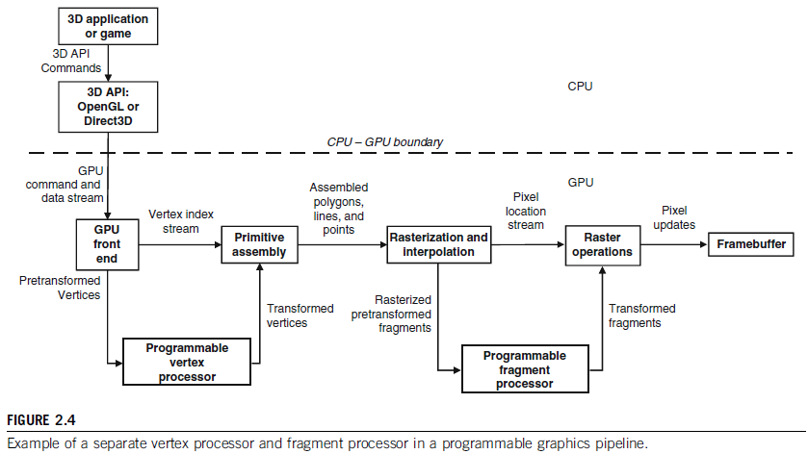
2.1.2 EVOLUTION OF PROGRAMMABLE REAL-TIME GRAPHICS (Contd..)
b/n the vertex processing stage and the pixel (fragment) processing stage is a rasterizer, that determines exactly which pixels (and portions thereof) lie within each geometric primitive’s boundaries.

